Slide 1
Lexicalization of PCFGs
Introduction
Christopher Manning
Notes:
Should add a slide on parsing speech lattices!
Explain queries chart must support for efficiency:
Is edge X:[i,j] already in the chart?
What edges with label Y end at position i?
What edges with label Z start at position j?

Slide 2
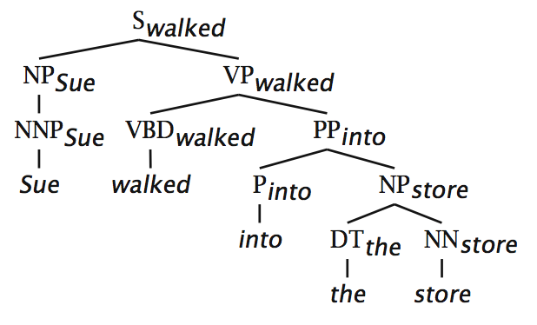
(Head) Lexicalization of PCFGs [Magerman 1995, Collins 1997; Charniak 1997]
The head word of a phrase gives a good representation of the phrase’s structure and meaning
Puts the properties of words back into a PCFG

Slide 3
(Head) Lexicalization of PCFGs [Magerman 1995, Collins 1997; Charniak 1997]
The head word of a phrase gives a good representation of the phrase’s structure and meaning
Puts the properties of words back into a PCFG
Notes:
Say how week a PCFG rule is.
Circle bilexical dependencies
Explain monolexical part: don’t even get that VP → VBD PP is likely because verb is “walked”

Slide 4
(Head) Lexicalization of PCFGs [Magerman 1995, Collins 1997; Charniak 1997]
The head word of a phrase gives a good representation of the phrase’s structure and meaning
Puts the properties of words back into a PCFG
Notes:
Circle bilexical dependencies

Slide 5
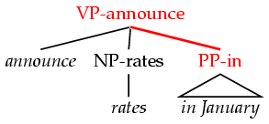
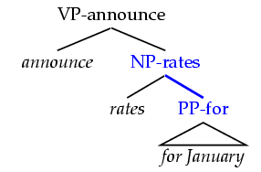
(Head) Lexicalization of PCFGs [Magerman 1995, Collins 1997; Charniak 1997]
Word-to-word affinities are useful for certain ambiguities
PP attachment is now (partly) captured in a local PCFG rule.
Think about: What useful information isn’t captured?
Also useful for: coordination scope, verb complement patterns
VP
VP
NP
PP
NP
PP
announce RATES FOR January
ANNOUNCE rates IN January

Slide 6
Lexicalized parsing was seen as the parsing breakthrough of the late 1990s
Eugene Charniak, 2000 JHU workshop: “To do better, it is necessary to condition probabilities on the actual words of the sentence. This makes the probabilities much tighter:
p(VP → V NP NP) = 0.00151
p(VP → V NP NP | said) = 0.00001
p(VP → V NP NP | gave) = 0.01980 ”
Michael Collins, 2003 COLT tutorial: “Lexicalized Probabilistic Context-Free Grammars … perform vastly better than PCFGs (88% vs. 73% accuracy)”

Slide 7
Lexicalization of PCFGs
Introduction
Christopher Manning
Notes:
Should add a slide on parsing speech lattices!
Explain queries chart must support for efficiency:
Is edge X:[i,j] already in the chart?
What edges with label Y end at position i?
What edges with label Z start at position j?

